Slide 1
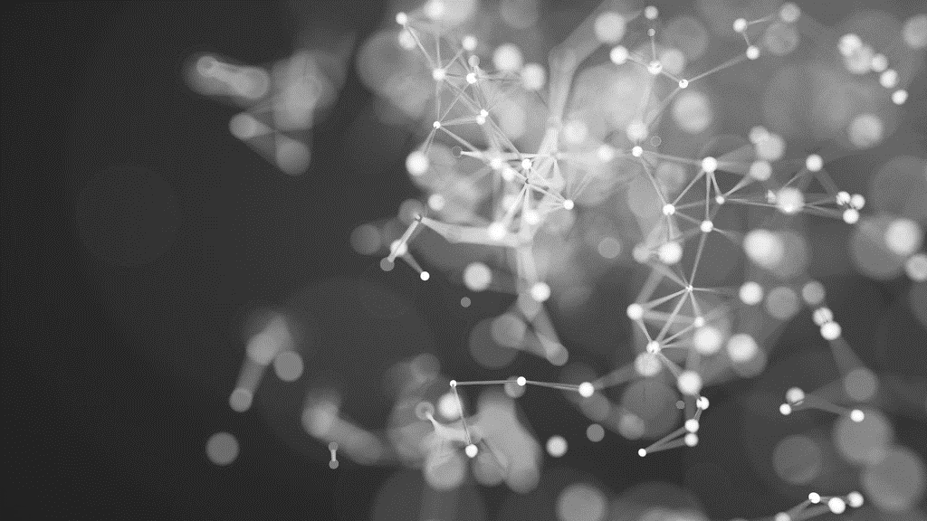
Final Portfolio Comp Vision Patricia McManus ITAi-1378 Saima Sano

Slide 2
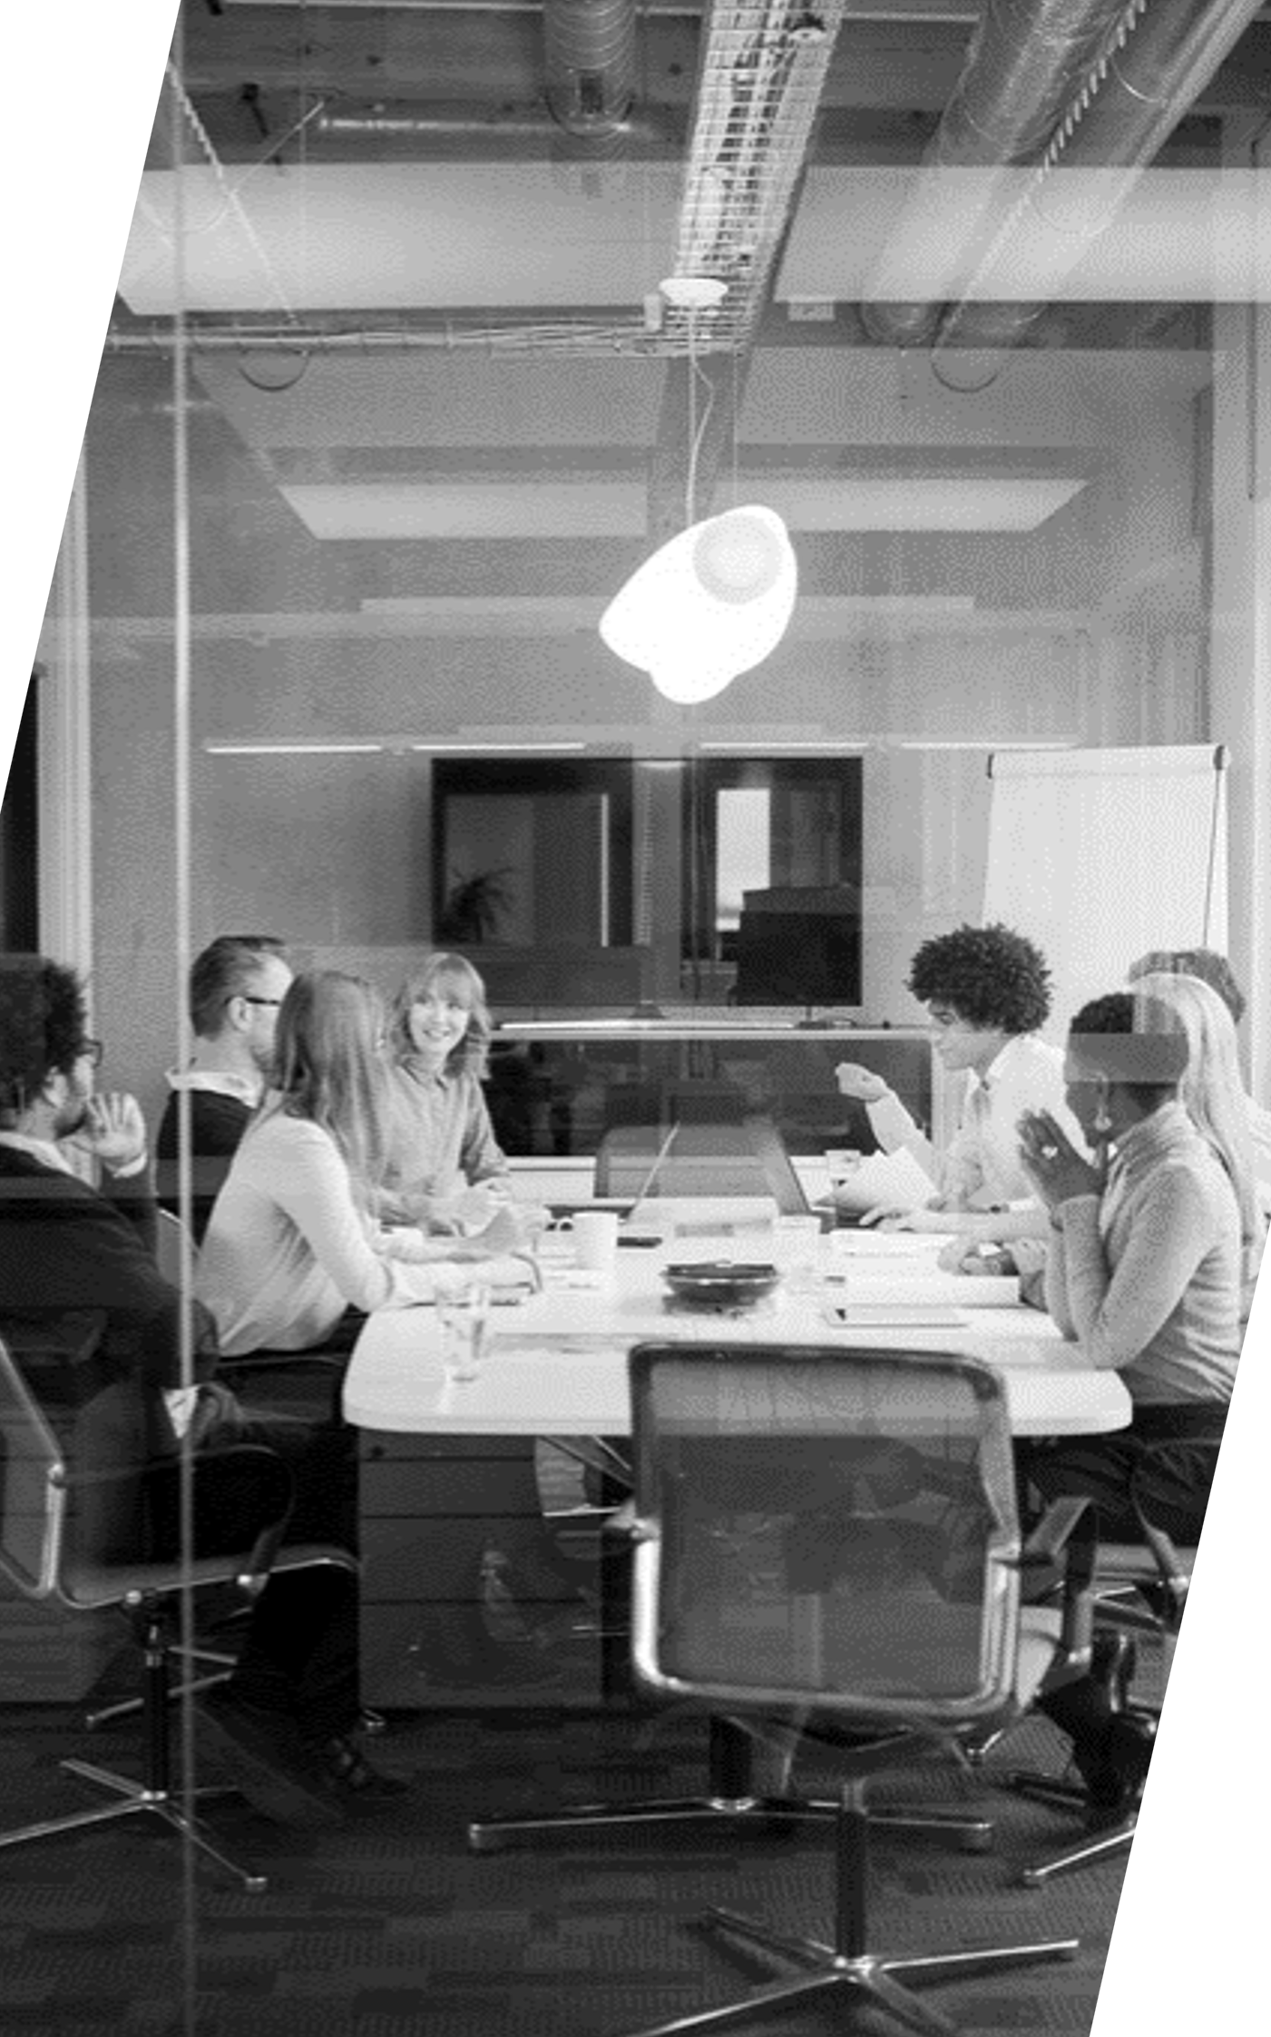
Key features
GitHub Repository
Experience in making this portfolio
Knowledge gained from this course

Slide 3

OVERCOMING Hurdles
Learning every step of the way

Slide 4
Creation of GitHub Repository
Creating my GitHub repository came with its challenges, particularly when I struggled to upload folders and files correctly. Initially, I faced difficulties in organizing and pushing the content to the repository, which made the process frustrating. To overcome this, I watched YouTube tutorials and researched solutions to understand GitHub’s interface and functionality better. The tutorials provided clear guidance on how to manage files, commit changes, and organize folders in the repository.
After gaining this understanding, I took a more systematic approach: I created individual folders on my computer for each module, wrote reflections for each one, and then uploaded the files to the repository. This method allowed me to stay organized and ensured that the repository was structured properly. Despite the initial challenges, this process helped me build confidence in using GitHub and reinforced the importance of patience and problem-solving when working with new tools.

Slide 5
Image Classification through SVM
The Support Vector Machine (SVM) algorithm is a powerful supervised learning method that identifies the optimal hyperplane to classify data. In the context of image classification, it excels in distinguishing between classes by leveraging kernel functions to handle non-linear separations. During this project, I learning about different terminology of SVM, we used CIFAR-10 data set. this data set have 600 images for each of the ten classes. I learned about hyperplane, precision, recall and F1-Score. It help me understand that computer changes each image to greyscale inorder image her properly.

Slide 6
Image Classification, Basic CNN and
Transfer Learning
This lab was an engaging introduction to the challenges of image classification, particularly distinguishing between visually similar objects like chihuahuas and muffins. By working through the dataset, I learned how to preprocess images, extract meaningful features, and apply machine learning algorithms for classification. The task highlighted the importance of using robust features and fine-tuning the model to handle subtle differences.
One challenge was ensuring the model could generalize well, as overfitting occurred during early iterations. I addressed this by augmenting the dataset and adjusting hyperparameters. The lab also underscored the value of visualization techniques in understanding the model's decisions. Overall, this experience enhanced my understanding of image classification and the intricacies involved in creating reliable models for real-world applications.

Slide 7
Manual CNN
Manually performing convolution operations was an enlightening experience that deepened my understanding of the core mechanics of Convolutional Neural Networks (CNNs). By manually applying filters (kernels) to an input matrix and calculating feature maps step-by-step, I learned how CNNs extract features like edges, textures, and patterns from images. This exercise reinforced the significance of kernel size, stride, and padding in determining the output dimensions and the level of detail captured.
One challenge was ensuring accuracy while computing the convolutions, as even small errors in calculations could lead to incorrect feature maps. To address this, I worked systematically, rechecking computations and visualizing the process to confirm correctness. This hands-on approach highlighted the role of each component in the convolution operation and how parameter choices affect the feature extraction process.

Slide 8
Convolutional Neural Network
This lab highlighted the efficiency of Convolutional Neural Networks (CNNs) in image classification tasks compared to traditional neural networks. Unlike traditional neural networks, which process flattened input data, CNNs maintain the spatial structure of images using convolutional and pooling layers. These layers extract hierarchical features, such as edges, textures, and complex patterns, making CNNs particularly suited for distinguishing visually similar objects like muffins and chihuahuas.

Slide 9
Object Detection Model
The object detection lab was a valuable learning experience, but it highlighted the challenges involved in accurately detecting and classifying objects in images. Despite applying various algorithms and tuning parameters, the results were not as accurate as expected. One of the main issues was the misidentification or incomplete detection of objects, which likely stemmed from insufficient training data or limitations in the model's architecture.
This experience taught me the importance of dataset quality, model selection, and hyperparameter tuning in achieving accurate object detection. While the lab didn't provide perfect results, it emphasized the need for continuous refinement, good computational power, and validation of models. The challenges faced also deepened my understanding of the complexity involved in real-world computer vision tasks and how even small improvements in data and model design can significantly enhance performance.

Slide 10
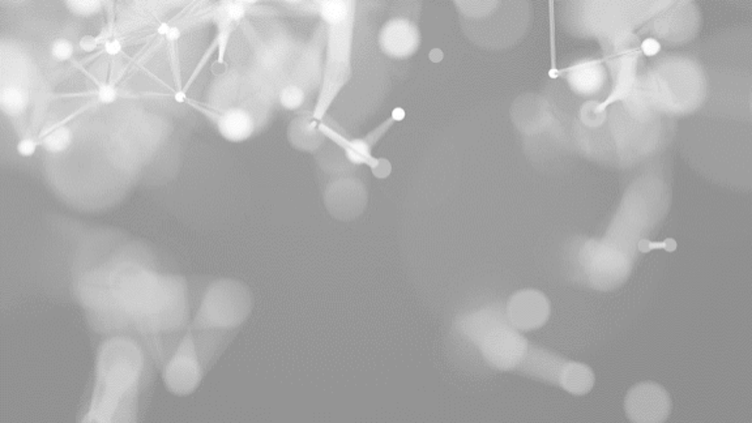
Thank you for taking the time to review my presentation. Throughout this course, I have gained valuable skills in computer vision (CV), including image classification, object detection, and the application of deep learning techniques like CNNs and GANs. I have also developed a strong understanding of reinforcement learning and its application in tasks such as training AI agents for games like Flappy Bird. These skills have been complemented by hands-on experience using platforms like TensorFlow and GitHub for managing and deploying projects. I am excited to continue building on this knowledge and applying it to real-world challenges in computer vision. Thank you again for your attention and support throughout my learning journey.

